Slide 1


Slide 2

Presented by Rivka Aizen
052-7144030
rivki403@gmail.com
@ All rights reserved

Slide 3
Outline
Introduction - What is Directive?
Demo – Slider Example
Normalizations – How Angular Normalizes directive
Directive Definition Object – The properties definition of directive
directive order executing – $compile order executing
Notes:
We’ll start with an introduction about why you should be using Directive
Then we’ll move on all options of directive definition object
We’ll then talk about some of the more critical components of directive : understanding of scope and Isolate scope the difference.
After that we will move on understandaing of order executing
Finally we’ll have some conclusion

Slide 4
Introduction
What is Directive and how to use it?

Slide 5
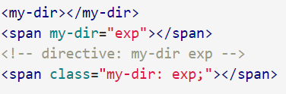
What is Directive?
Directives is a markers on a DOM element, Extends the standard HTML behaviour
Markers such as: element name/ Attribute / comment / CSS class
For example:
Directives –Types:
built-in directive : Angular comes with a set of these directives built-in,
custom-directive: you can create your own directives for Angular to use

Slide 6
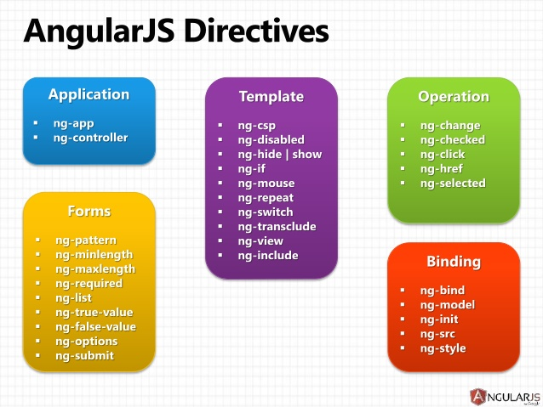
Build-in directives:
Notes:
יש לאנגולר כמה סוגי דיירקטיבים
---
לקרא את הרשימה
Binding: יצירה ואתחול משתנים

Slide 7

Why a directive?
Can define domain-specific tags (e.g. <order></order>)
Easier to read the HTML code
Reusability HTML component or for complex UI expressions , HTML behavior like events handlers or to wrap a jQuery plugin
Keep local scope

Slide 8
Demo Application
Words in action

Slide 9

Demo Application
photo-gallery slider:
Notes:
A drop down has several languages.
Choosing a language will output the days of the week in that language.
There is a module that controls the days of week, language information, and provides a directive.
The main module uses the services from the days of week module.
The index.html uses the directive from the days of week module.

Slide 10

Slider Example:
Step 1:
let’s create a controller that creates an array of ten image objects in its.
function photoCtrl($scope) {
var vm = this;
vm.images = [];
vm.length = 10;
activate();
function activate() {
for (var i = 1; i <= vm.length; i++)
{
vm.images.push({
title: 'Pic ' + i,
src: i + '.jpg',
});
}
}
}
Step 2: add “images” folder

Slide 11
Slider Example:
Step 3:
Write the controller template Markup
<div id="photo1">
<h1>Slider Using AngularJS</h1>
<div class="slider">
<div class="slide" ng-repeat="image in photo1Vm.images" ng-if="image.visible">
<img ng-src="/src/images/{{image.src}}" />
</div>
<div class="slide-bottom" ng-repeat="image in photo1Vm.imagesSmall">
<img ng-src="/src/images/{{image.src}}" />
</div>
<div class="arrows">
<a ng-click="photo1Vm.next()">
<img src="/src/images/right-arrow.png" />
</a>
<a ng-click="photo1Vm.prev()">
<img src="/src/images/left-arrow.png" />
</a>
</div>
</div>
</div>

Slide 12
Slider Example:
vm.currentIndex = 0; // Initially the index is at the first image
//get next or prev index
var getNextIndex = function (IsGetPrev) {
if (IsGetPrev)
return vm.currentIndex < vm.images.length - 1 ? vm.currentIndex + 1 : 0;
else
return vm.currentIndex > 0 ? vm.currentIndex-1: vm.images.length - 1;
}
//on click on next show the next image
vm.next = function () {
vm.currentIndex = getNextIndex(true);
changeCurrentIndex();
};
//on click on prev show the next image
vm.prev = function () {
vm.currentIndex = getNextIndex(false);
changeCurrentIndex();
};
//on change CurrentIndex change the imagesSmall list
function changeCurrentIndex() {
vm.images.forEach(function (image) {
image.visible = false; // make every image invisible
});
vm.images[vm.currentIndex].visible = true; // make the current image visible
vm.imagesSmall = [];
vm.imagesSmall.push(vm.images[getNextIndex(true)]);
vm.imagesSmall.push(vm.images[vm.currentIndex]);
vm.imagesSmall.push(vm.images[getNextIndex(false)]);
}
Step 4:
Update the Controller:

Slide 13
Slider Example:
#photo1 {
}
#photo1 * {
font-family: 'Open Sans', sans-serif;
}
#photo1 .center-grey {
background: #f2f2f2;
}
#photo1 .slider {
position: relative;
padding: 5px;
width: 610px;
height: 100%;
margin: auto;
margin-top: 40px;
}
#photo1 .slide {
position: relative;
box-shadow: 0px 0px 15px #999;
}
#photo1 .slide img {
height: 100%;
width: 100%;
}
#photo1 .slide-bottom {
position: relative;
display: inline;
}
#photo1 .slide-bottom img {
height: 33%;
width: 32.5%;
}
#photo1 .arrows {
position: absolute;
top: 10px;
right: 20px;
}
#photo1 .arrows img {
height: 32px;
}
#photo1 h1 {
text-align: center;
padding: 10px;
font-size: 40px;
color: #222;
}
Step 5:
Update the Css page:

Slide 14
Slider Example:
Step 6:
Change changeCurrentIndex function to $scope.$watch():
And remove calling function changeCurrentIndex
$scope.$watch(function () { return vm.currentIndex; }, changeCurrentIndex);

Slide 15
Slider Example:
Step 7 (Bonus):
we might also want our slider to automatically slide to the next image after an interval.
var timer;
var sliderFunc = function () {
timer = $timeout(function () {
vm.next();
timer = $timeout(sliderFunc, 5000);
}, 5000);
};
$scope.$on('$destroy', function () {
$timeout.cancel(timer); // when the scope is getting destroyed, cancel the timer
});

Slide 16
Normalization
How Angular normalizes directive

Slide 17
Normalization
Angular normalizes an element's tag and attribute name to determine which elements match which directives.
Define directive name: write camelCase normalized name (e.g. ngModel).
Refer directive on Dom: since HTML is case-insensitive we write lower-case forms, typically using dash-delimited (e.g. ng-model).

Slide 18
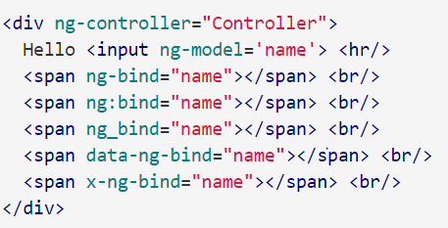
Normalization
The normalization process is as follows:
Strip x- and data- from the front of the element/attributes.
Convert the :, -, or _-delimited name to camelCase
For Example:

Slide 19
Normalization
Use a unique prefix
Avoids clashing with others
Easier for readers to identify
Don’t use “ng-“ for your custom prefix
Common convention: two letters
The AngularUi project uses “ui-“

Slide 20
DDO- Directive Definition Object
The properties definition of directive

Slide 21
Directive Definition Object
Object returned by directive declaration that provides instructions to the compiler
myModule.directive('directiveName', [function() { return { priority: 0, template: '<div></div>', // or // function(tElement, tAttrs) { ... }, // or // templateUrl: 'directive.html', // or // function(tElement, tAttrs) { ... }, transclude: false, restrict: 'A', // "AEMC" templateNamespace: 'html', // 'html', 'svg', 'math' scope: false, // true, {} controller: function($scope, $element, $attrs, $transclude, otherInjectables) { ... }, controllerAs: 'stringAlias', require: 'siblingDirectiveName', // or // ['^parentDirectiveName', '?optionalDirectiveName', '?^optionalParent'], compile: function compile(tElement, tAttrs, transclude) { return { pre: function preLink(scope, iElement, iAttrs, controller) { ... }, post: function postLink(scope, iElement, iAttrs, controller) { ... } } // or // return function postLink( ... ) { ... } }, // or // link: { // pre: function preLink(scope, iElement, iAttrs, controllers) { ... }, // post: function postLink(scope, iElement, iAttrs, controllers) { ... } // } // or // link: function postLink( ... ) { ... } }; }]);
Notes:
How many people have heard of or know what the MVC is?
For the rest of us…
**
[ Read definitions ]
**
It is important to note that a MVC system can exist for the browser, the server, and even the database.
We’ll be talking about the MVC on the browser.

Slide 22
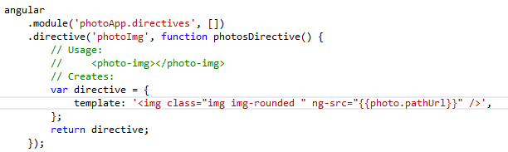
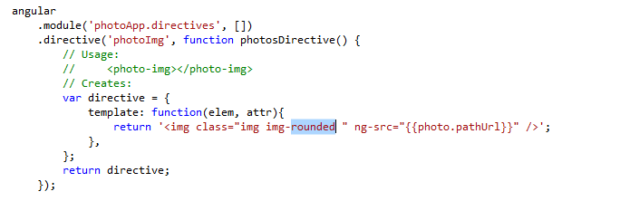
template
Replace the current element with the contents of the HTML string.
You can specify template as:
A String:
A function:
Remark: you can’t specify two directive with template property at the same element

Slide 23
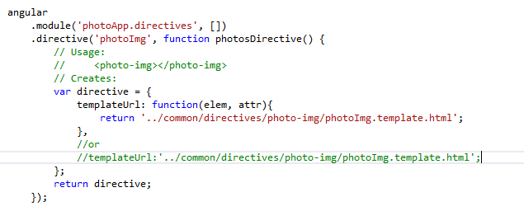
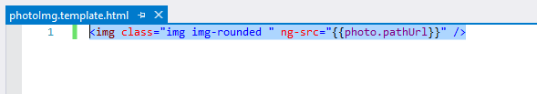
templateUrl
Same as template but the template is loaded from the specified URL. Because the template loading is asynchronous the compilation/linking is suspended until the template is loaded.
Best Practice : Unless your template is very small, it's typically better to break it apart into its own HTML file and load it with the templateUrl option..
For example:
and template:
Notes:
templateUrl Best Practice:
It is prevent mistakes at string
It is good to prepare for angular 2

Slide 24
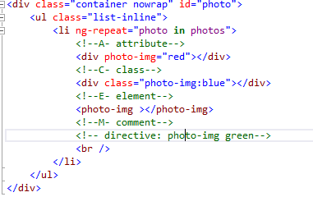
restrict
Restricts the directive to a specific directive DOM declaration style. If omitted, the default (“EA” only) is used.
E - Element name
A - Attribute (default)
C - Class
M – Comment
Notes:
<!--A- attribute-->
<div photo-img="red"></div>
<!--C- class-->
<div class="photo-img:blue"></div>
<!--E- element-->
<photo-img></photo-img>
<!--M- comment-->
<!-- directive: photo-img green-->
<br />
(function () {
'use strict';
angular
.module('photoApp.directives')
.directive('photoImg', function photosDirective($log) {
var directive = {
templateUrl: function (tElem, tAttr) {
$log.debug("tElem:", tElem, "tAttr:", tAttr);
var color = "black";
if (tAttr.photoImg) color = tAttr.photoImg;
if (color == "green") tElem.after(color);
else tElem.css("border", "1px solid" + color);
return '../common/directives/photo-img/photoImg.template.html';
},
// restrict: 'EACM'
};
return directive;
});
})();
<img class="img img-rounded " ng-src="{{photo.pathUrl}}" />

Slide 25
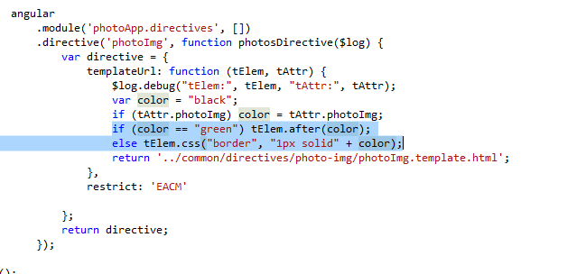
restrict
Remarks:
These restrictions can all be combined as needed: 'AEC' - matches either attribute or element or class name
you can specify value (e.g photo-img=“red”) and get it in directive like that: tAttr. photoImg, you don’t have that option at element. (see below example)
comment not rendering at page but you can use it like that:

Slide 26
link
The link function is responsible for registering DOM listeners as well as updating the DOM. It is executed after the template has been cloned.
function link(scope, element, attrs , controller) {}
scope - The scope of the directive.
element - Dom element where the directive is applied.
attrs – Collection of attributes of the Dom Element
controller - Array of controllers required by the directive.
This property is used only if the compile property is not defined.

Slide 27
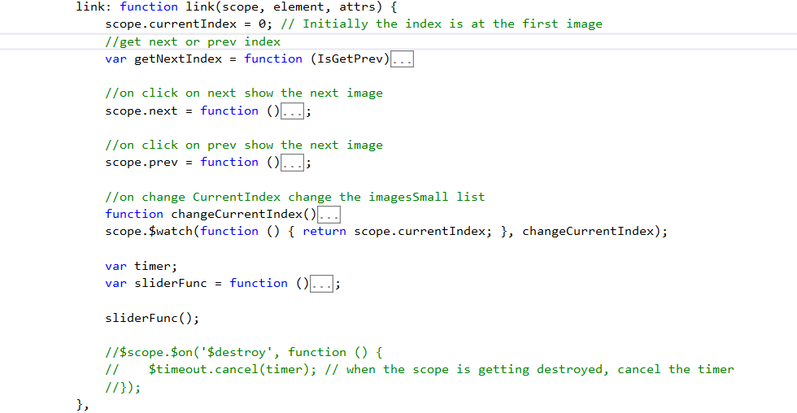
link: scope

Slide 28
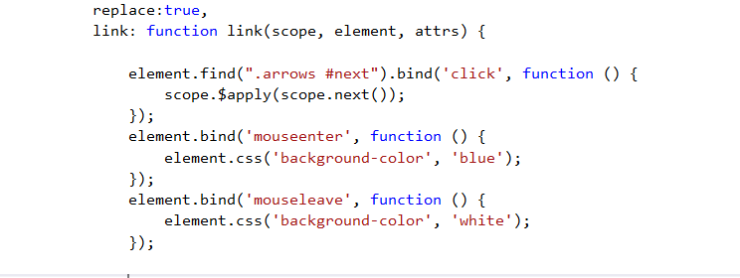
link : element
element is pre-warpped in jqlite object.
you can use directive for jQery manipulate for example:
Notes:
element.on('mouseover', function () {
element.css('background-color', 'red')
});
element.on('mouseout', function () {
element.css('background-color', 'white')
});
element.find('anext').bind('click', function () {
scope.$apply(scope.next)
});
<anext >next</anext>

Slide 29
jqLite options
addClass()
after()
append()
attr()
bind()
children()
clone()
contents()
css()
getComputedStyle()
data()
detach()
empty()
eq()
find()
hasClass()
html()
next()
on()
off()
one()
parent()
prepend()
prop()
ready()
remove()
removeAttr()
removeClass()
removeData()
replaceWith()
text()
toggleClass()
triggerHandler()
unbind()
val()
wrap()

Slide 30
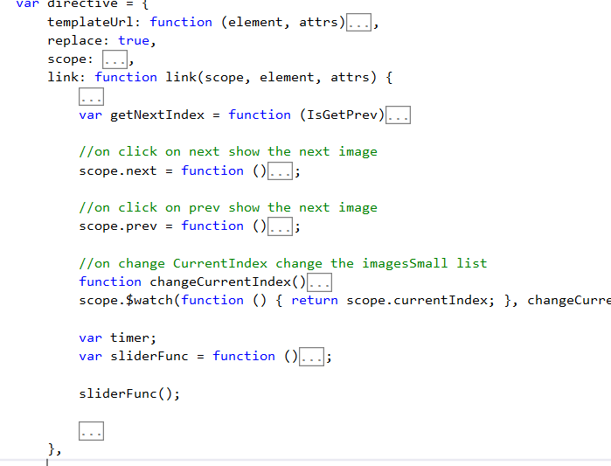
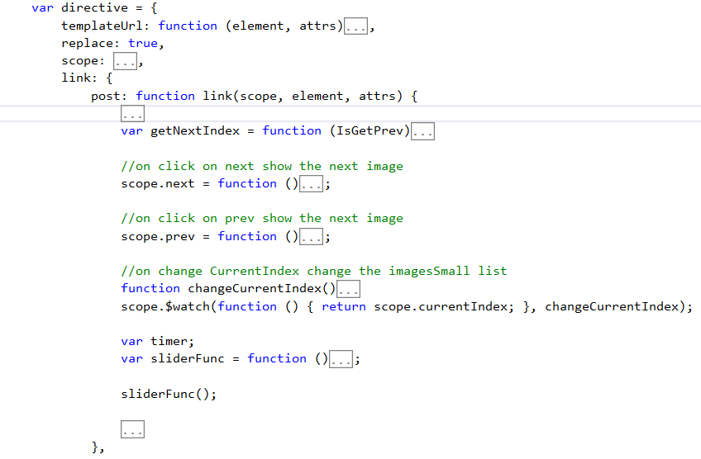
link
AngularJs allows to set the link property to an object also. Advantage of having an object is, we can split the link function into two separate methods called, pre-link and post-link

Slide 31
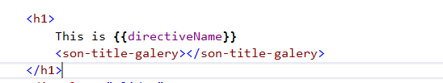
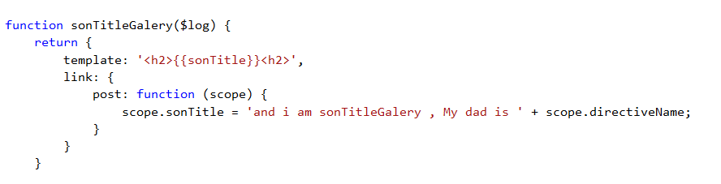

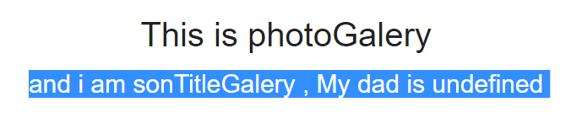
link
let’s try add title to directive and put son directive in the directive. The son directive get in post link the parent directive name and concat it in its string, Notice that the dad’s name is undefined ?
dad directive:
son directive:
Resault:
Notes:
.directive('sonTitleGalery', sonTitleGalery)
function sonTitleGalery($log) {
return {
template: '<h2>{{sonTitle}}<h2>',
require: '^photoGalery',
link: {
post: function (scope, ele, attr, ctrl) {
scope.sonTitle = 'and i am sonTitleGalery , My dad is ' + ctrl.directiveName;
}
}
}
}
<h1>
This is {{directiveName}}
<son-title-galery></son-title-galery>
</h1>

Slide 32
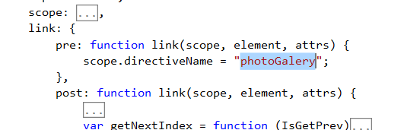
link
Now let’s analyze what happened. Here, both the dad and son directives have link functions, and both these link functions are post-links. When a directive contains multiple child directives, all of the child directive’s link functions executed first then the parent directive link function. So, in this case, when son directive’s link function executes, the dad directive is still not linked the data to the template. That’s why the son directive outputs the dad’s name as undefined.
How to solve this issue?
This is where the pre-link comes handy. A pre-link function of a directive will get executed before all of its child directives’ link functions. Let’s modify our dad directive :
Dad’s name is now available to the son.

Slide 33
link: Summary
post:
Pre
This is the most commonly used for data binding
Safe to attach event handlers to the DOM element
All children directives are linked, so it’s safe to access them
Never set any data required by the child directive here. Because child directive’s will be linked already
Used rarely. One of the use case is when a child directive requires data from its parent, the parent directive should set it through its pre-link function
Set data required for its child directives
Safe to attach event handlers to the DOM element
Not safe to access DOM elements belong to child directives. They’re not linked yet.

Slide 34
scope
Options:
false: (default) inherits from a parent scope
true: a new scope will be created for this directive
{} : a new isolated scope is created

Slide 35
scope: Isolated scope
This isolated scope does not inherit from a parent scope. Useful when creating reusable components, which should not accidentally read or modify data in the parent scope. The isolate scope object defines the properties of the local scope. Used to pass data to the directive. The keys of the isolate scope object are the property names. The values define the relationship.
The possible values are:
@ - binds to a string value.
= - two way binding to an object
& - Binding to an expression Optionally
these can all be followed by an attribute name, If no attribute name is given, the name is assumed to be the same as the key

Slide 36
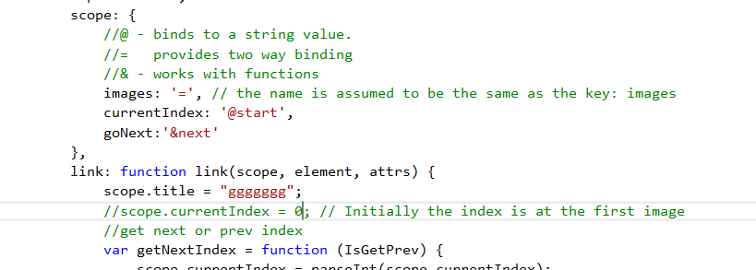
scope: Isolated scope
For example:

Slide 37
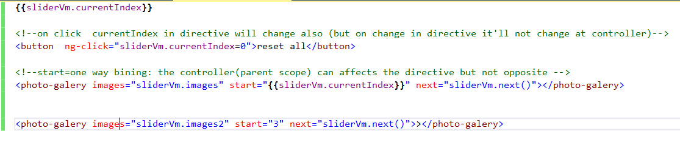
scope: Isolated scope
Implement in controller:

Slide 38
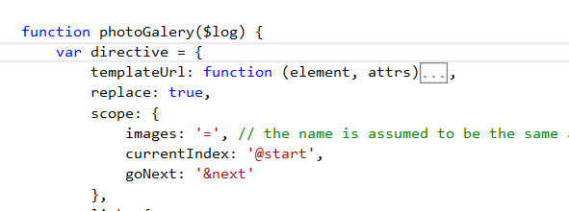
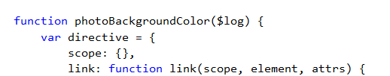

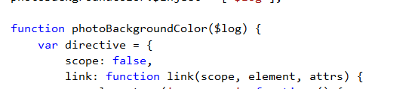
scope: multiple directives
If multiple directives on the same element request a new scope(true), only one new scope is created.
isolate scope directive can’t be two directives with : isolate scope ({}) or a new scope (true) it can be only with inherits scope directive(false)

Slide 39
priority
The priority is only relevant when you have multiple directives on one element. The priority determines in what order those directives will be applied/started , from highest to lowest. The default is 0.
In most cases you wouldn't need a priority, but sometimes when you use the compile function, you want to make sure that your compile function runs first.
Notes:
In the jQuery example, we manually bound the data by setting up event listeners.
**
Angular sets up these bindings for us and keeps track of when things change.
**
In the previous HTML we can see multiple places where the HTML is receiving some sort of binding from Angular

Slide 40
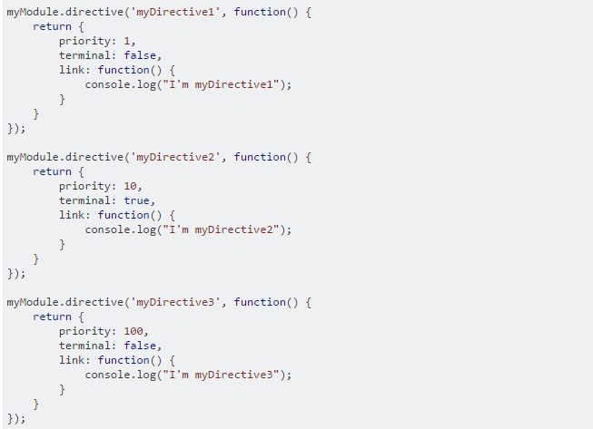

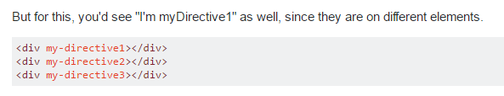
terminal
The terminal property is also only relevant for directives that are on the same HTML element. The terminal property tells Angular to skip all directives on that element that comes after it (lower priority). So this code might clear it up:
Notes:
**
An expression is a snippet of JavaScript that can be evaluated and returns some value
These three lines each contain at least one expression.
**
Angular allows you to easily evaluate expressions within your HTML.
Often this is done using the squiggly brackets, but expressions can also be evaluated elsewhere.
It is important to know that AngularJS expressions are not a direct equivalent of JavaScript expressions, event within the context of the AngularJS scope.

Slide 41
Controller
Controller function, or string name of the controller for the directive. The can be shared with other directives by using require attribute. The controller is provided the following injectable items:
$scope - Current scope associated with the element
$element - Current element
$attrs - Current attributes object for the element
$transclude - A transclude linking function pre-bound to the correct transclusion scope. The scope can be overridden by an optional first argument. function([scope], cloneLinkingFn).
Consider using a controller instead of large link function. This provides separation and enhanced testability.
For understand order executing: http://plnkr.co/edit/CW7cF0?p=preview

Slide 42


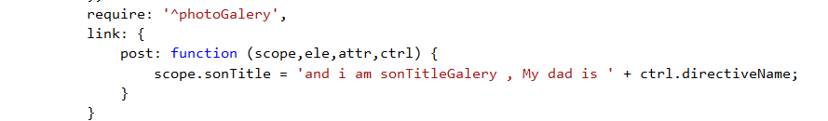
Controller
Changing post-link to pre-link will solve the above problem. However, it’s not a best practice to create pre-link functions whenever we introduce a child directive. Assume, if instead of a child directive, what if we want to share some data to another directive applied to the same DOM element ?
Directive’s controller is designed for that. A controller is a place where directive can define it’s public API. Let’s solve the above problem in controller way.
Or:
dad directive:
dad directive:
son directive:

Slide 43
Controller
Order of Execution
Controller gets executed first
Pre-link gets executed next
Post-link gets executed last
Summary:
Set the data required to other directives.
Never access DOM element inside the controller; it’s against Angular’s philosophy and make testing hard.
Best Practice: use controller when you want to expose an API to other directives. Otherwise use link.

Slide 44
require
Require another directive and inject its controller as the fourth argument to the linking function. Takes a string name (or array of strings) of the directive(s) to pass in. If an array is used, the injected argument will be an array in corresponding order.
The name can be prefixed with:
(no prefix) - Locate the required controller on the current element. Throw an error if not found
? - Attempt to locate the required controller or pass null to the link fn if not found. Makes it optional
^ - Locate the required controller by searching the element’s parents. Throw an error if not found.
?^ - Attempt to locate the required controller by searching the element’s parents or pass null to the link fn if not found.

Slide 45
controllerAs
If using a controller function, you can use the ‘controller as’ syntax. Directive must define an isolated scope if this option is used. If using a string for the controller attribute, ‘controller as’ can be used.

Slide 46
transclude
compile the content of the element and make it available to the directive. Typically used with ngTransclude. The advantage of transclusion is that the linking function receives a transclusion function which is pre-bound to the correct scope. In a typical setup the widget creates an isolate scope, but the transclusion is not a child, but a sibling of the isolate scope.
The value can be:
true - transclude the content of the directive. ‘element’ - transclude the whole element including any directives defined at lower priority.

Slide 47
type
String representing the document type used by the markup. This is useful for templates where the root node is non-HTML content (such as SVG or MathML). The default value is “html”.
html - All root template nodes are HTML, and don’t need to be wrapped. Root nodes may also be top-level elements such as <svg> or <math>.
svg - The template contains only SVG content, and must be wrapped in an <svg> node prior to processing.
math - The template contains only MathML content, and must be wrapped in an <math> node prior to processing.
If no type is specified, then the type is considered to be html

Slide 48
type
. Here is the function that leverages it inside the $compile service where the directive API lives from the source:
function wrapTemplate(type, template) {
type = lowercase(type || 'html');
switch (type) {
case 'svg':
case 'math':
var wrapper = document.createElement('div');
wrapper.innerHTML = '<' + type + '>' + template + '</' + type + '>';
return wrapper.childNodes[0].childNodes;
default:
return template;
}
}

Slide 49
compile
The compile function deals with transforming the template DOM. Since most directives do not do template transformation, it is not used often.

Slide 50
directive order executing
The nitty-gritty of compile and link functions inside AngularJS directives

Slide 51
Compile order
Consider the following HTML markup:
and the following JavaScript:
var app = angular.module('app.test', []);
function createDirective(name) {
return function () {
return {
restrict: 'E',
compile: function (tElem, tAttrs) {
console.log(name + ': compile => ' + tElem.html());
return {
pre: function (scope, iElem, iAttrs) {
console.log(name + ': pre link => ' + iElem.html());
},
post: function (scope, iElem, iAttrs) {
console.log(name + ': post link => ' + iElem.html());
}
}
}
}
}
}
app.directive('levelOne', createDirective('levelOne'));
app.directive('levelTwo', createDirective('levelTwo'));
app.directive('levelThree', createDirective('levelThree'));
<level-one>
<level-two>
<level-three>
Hello {{name}}
</level-three>
</level-two>
</level-one>

Slide 52
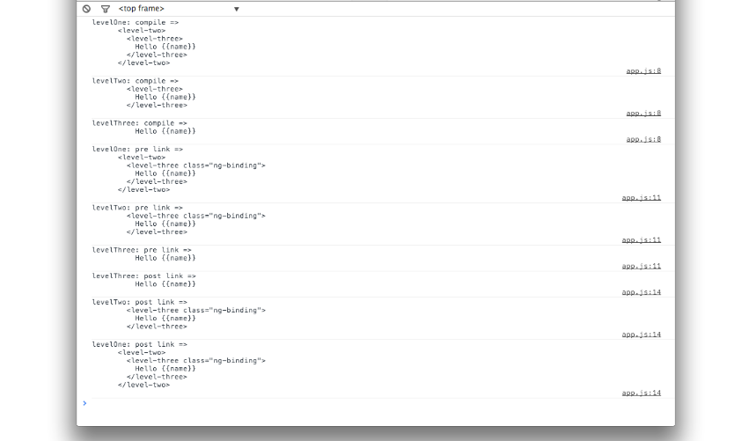
Compile order
The output:

Slide 53
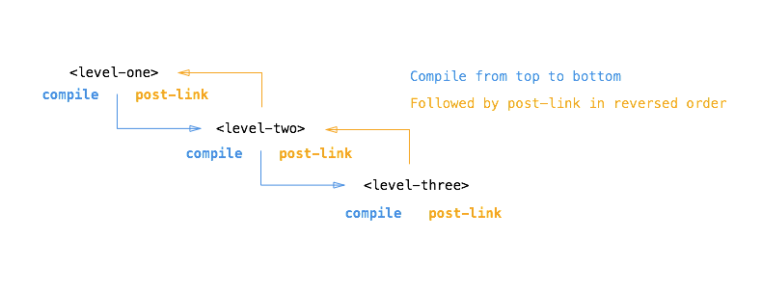
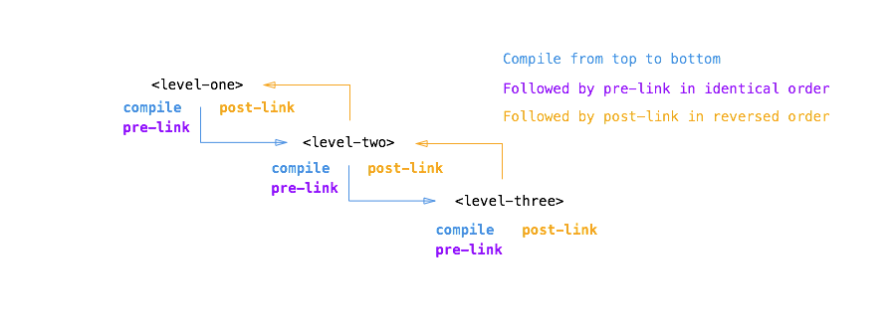
Compile order
So The order is like that:

Slide 54
Resources
Official Tutorial – https://docs.angularjs.org/tutorial
Official API compile– https://docs.angularjs.org/api/ng/service/$compile
Official API directive– https://docs.angularjs.org/api/ng/service/$compile
Terminal of directive – http://stackoverflow.com/questions/15266840/how-to-understand-the-terminal-of-directive
Prel-ink, post-link,controller of directive - http://www.undefinednull.com/2014/07/07/practical-guide-to-prelink-postlink-and-controller-methods-of-angular-directives/ compilation order – http://jasonmore.net/angular-js-directives-difference-controller-link/

